Slide 1

Sales Data Analysis
A Formal Report on Key Trends and Patterns

Slide 2

Introduction & Objectives
This report analyzes sales data to uncover key trends and patterns in sales performance. Our aim is to provide insights into sales distribution, performance metrics, and areas for improvement.
Understand sales distribution by country.
Evaluate performance metrics.
Identify potential areas for improvement.

Slide 3

Dataset Overview
Basic Information
Key Observations
Rows: 1,000+
No missing values or duplicates.
Columns: Sales Person, Country, Product, Date, Amount, Boxes Shipped
Data types correctly assigned.
Data Summary: Boxes Shipped
Mean: 161.80 | Standard Deviation: 121.54 | Min: 1 | Max: 709

Slide 4
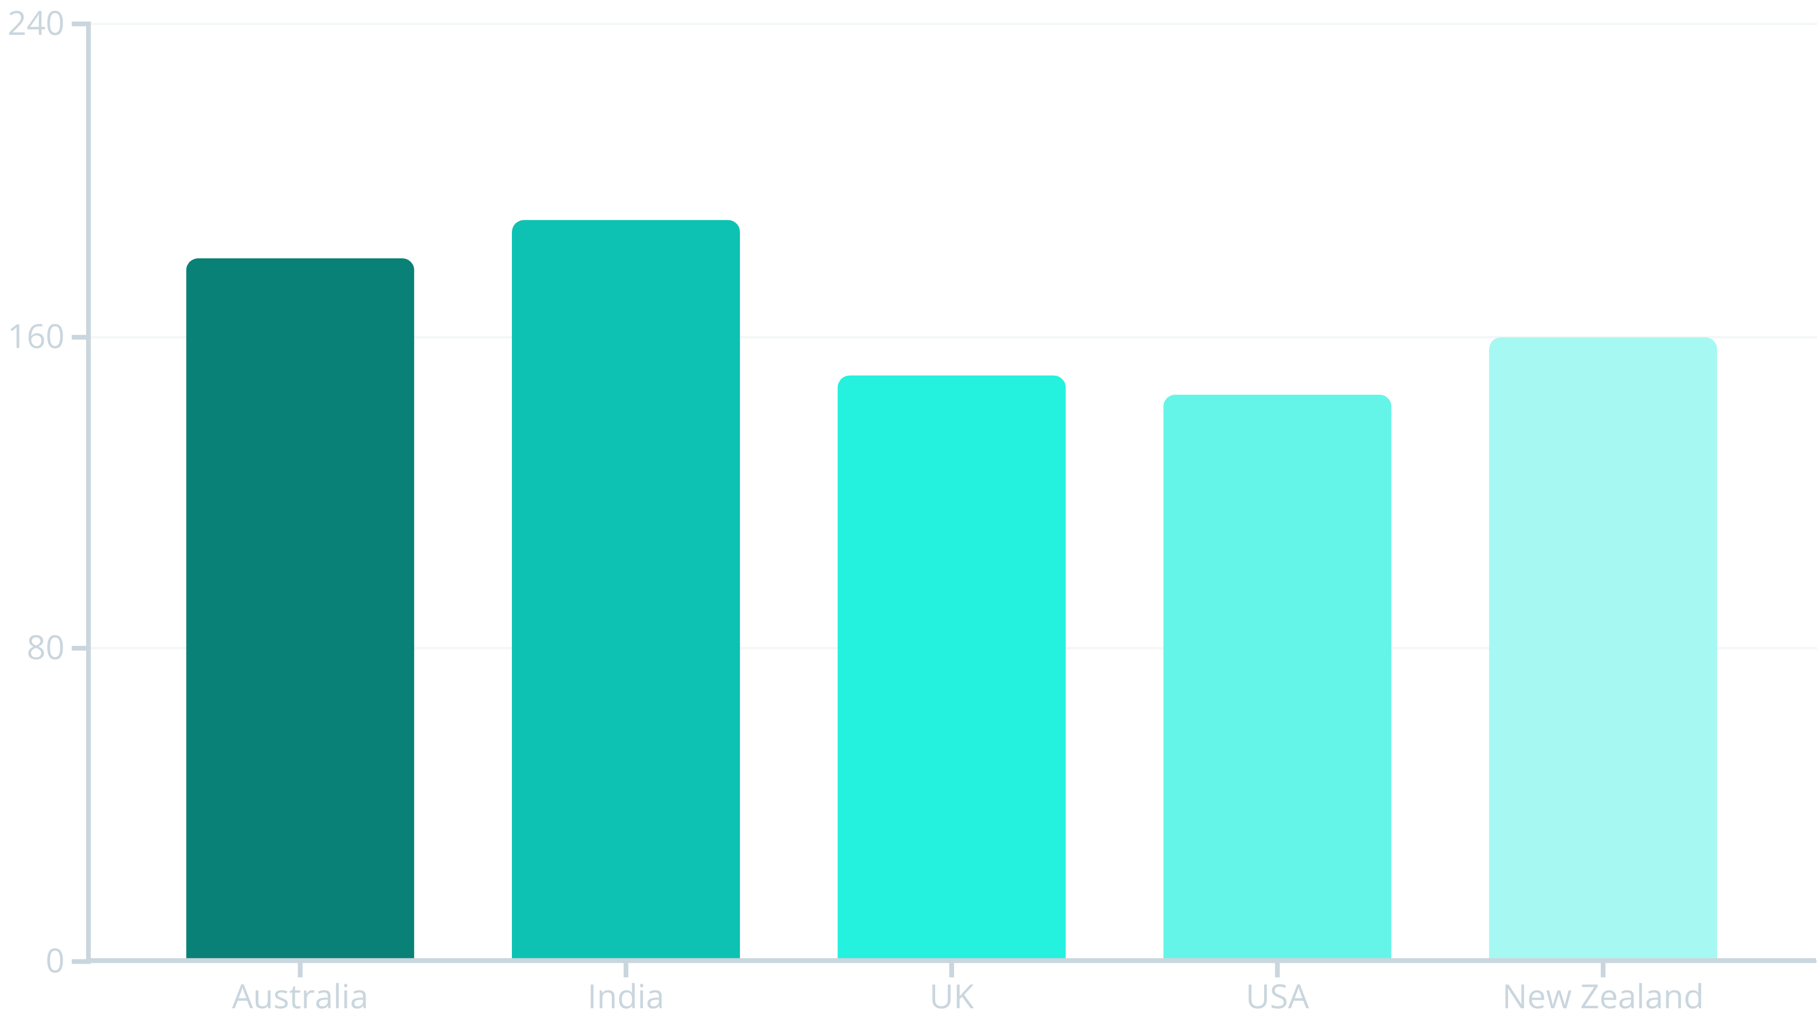
Sales Distribution by Country
Australia and India show higher variability in boxes shipped, while the UK and USA have consistent volumes. New Zealand has fewer transactions but moderate shipments.

Slide 5
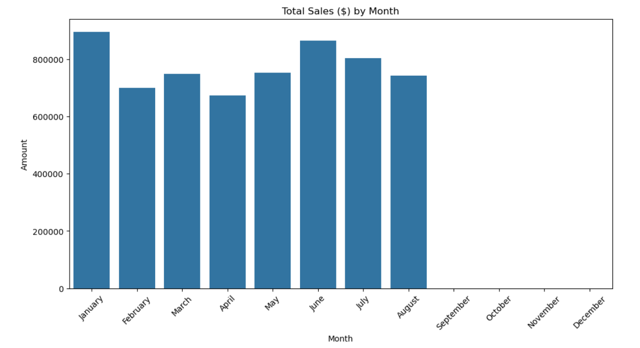
Total sells ($) per month

Slide 6
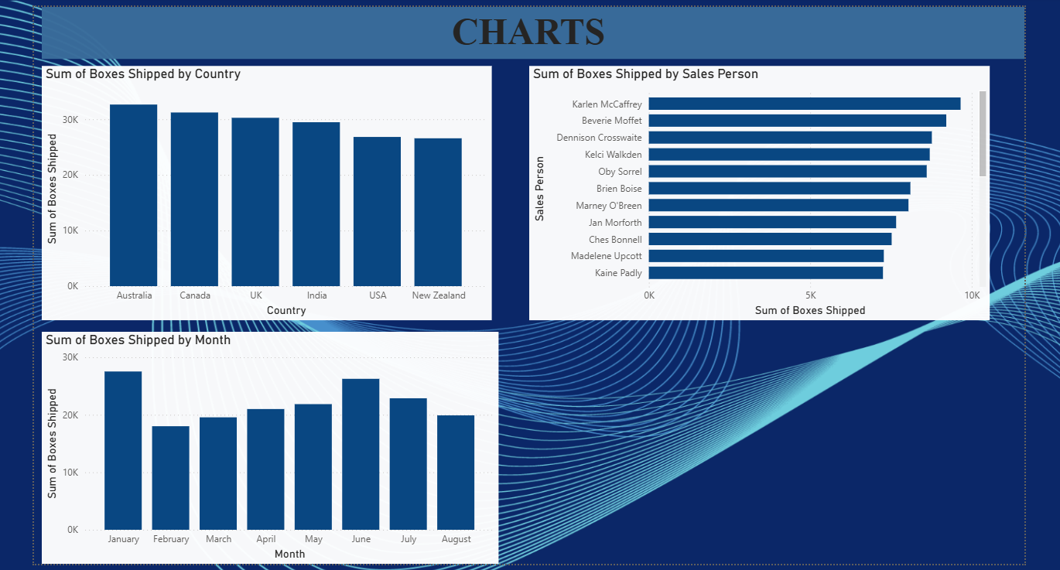
Power bi analysis

Slide 7
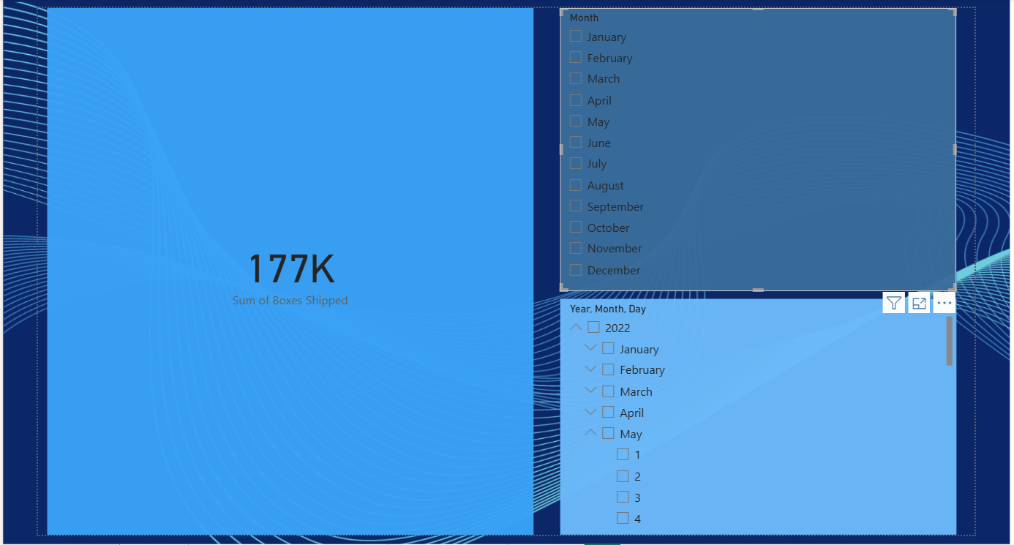

Slide 8


Key Findings: Variability & Quality
Sales Variability
Data Quality
Significant variability in sales performance across countries, with Australia and India showing the highest fluctuations in boxes shipped.
The dataset is clean and well-structured, with no missing values. The "Amount" column was successfully cleaned for numerical analysis.

Slide 9

Statistical Summary
161.80
16,179.80%
Average Boxes Shipped
Shipping Rate
Indicates high variability in shipment sizes.
Per transaction, indicating a wide range from 1 to 709 boxes.

Slide 10



Potential Further Analysis
Correlation
Seasonal Trends
Performance
Explore the relationship between "Amount" and "Boxes Shipped."
Identify patterns in sales based on time of year.
Analyze individual salesperson or product performance.

Slide 11
Recommendations: Strategic Focus
Targeted Strategies
Performance Metrics
Focus on countries with high variability (e.g., Australia, India) to understand sales fluctuations.
Track salesperson and product popularity to identify top performers and underperforming areas.

Slide 12

Recommendations: Forecasting
Utilize the clean dataset to build robust sales forecasting models. Leverage historical date and amount data to predict future trends and optimize inventory and resource allocation.

Slide 13

Prepared By
Philemon MUVUNYI Introduction to Bigdata Course Date: 2nd, July 2025 Contact: muvunyiphilemon22@gmail.com
Dataset link: https://chandoo.org/wp/wp-content/upl...
Github repo: https://github.com/Philemon5MUVUNYI/Bigdata_Capstone_Project/tree/main

